Slide 1


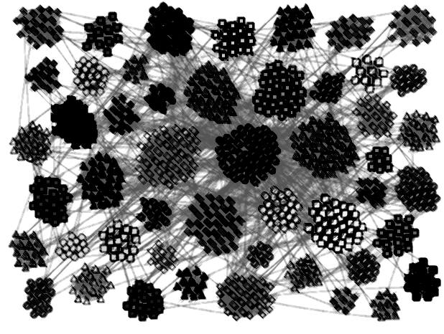


An Evaluation of Community Detection Algorithms on Large-Scale Email Traffic
Farnaz Moradi,
Tomas Olovsson, Philippas Tsigas
Distributed Computing and Systems

Slide 2
Community
A community is a group of related nodes that
are densely interconnected
have fewer connections with the rest of the network

Slide 3
Community Structure
Many real networks have community structure
Social networks
Web graph
P2P networks
Biological networks
Email networks
Community detection aims at unfolding the logical communities by only using the structral properties of the networks.
Zachary’s Karate Club

Slide 4
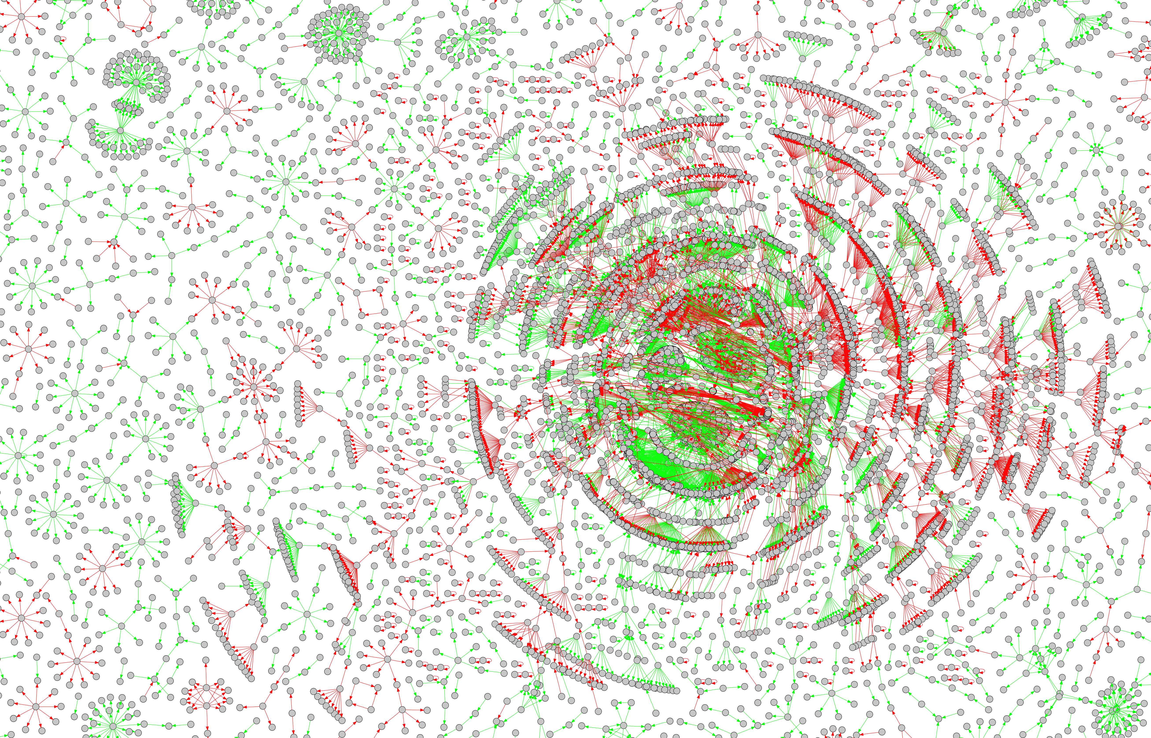
Separating legitimate (ham) and unsolicited (spam) email in a large-scale email network generated from real email traffic.
Assessing the quality of community detection algorithms in creating structural and logical communities.

Slide 5
Outline
Community detection algorithms
Quality functions
Structural quality
Logical quality
Experimental evaluation
Real email traffic

Slide 6
Community Detection
Flat
Hierarchical
Overlapping

Slide 7
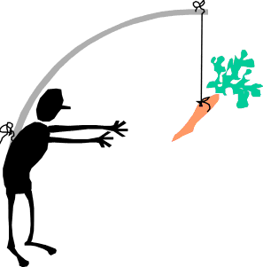
Motivation Experimental Evaluation
No consensus on which algorithm is more suitable for which type of network.
Experimental evaluation on synthetic graphs is not completely realistic [Delling et al. 2006]:
Implicit dependencies between:
community detection algorithms
synthetic graph generators
quality functions used to assess the performance of the algorithms
Empirical studies on real-world networks are crucial.

Slide 8
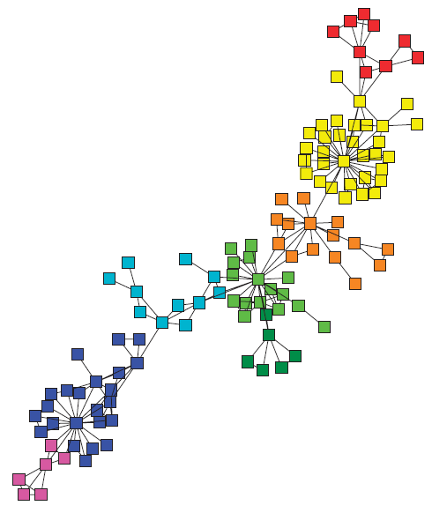
Community Detection Algorithms
Blondel (Louvian method), [Blondel et al. 2008]
Fast Modularity Optimization
Hierarchical clustering
Blondel L1: the first level of clustering hierarchy
Infomap, [Rosvall & Bergstrom 2008]
Maps of Random Walks
Flow-based and information theoretic
InfoH (InfoHiermap), [Rosvall & Bergstrom 2011]
Multilevel Compression of Random Walks
Hierarchical version of Infomap

Slide 9
Community Detection Algorithms
RN, [Ronhovde & Nussinov 2009]
Potts Model Community Detection
Minimization of Hamiltonian of an Potts model spin system
MCL, [Dongen 2000]
Markov Clustering
Random walks stay longer in dense clusters
LC, [Ahn et al. 2010]
Link Community Detection
A community is redefined as a set of closely interrelated edges
Overlapping and hierarchical clustering

Slide 10
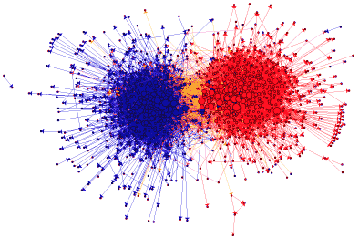
Quality Functions
Used to assess the quality of the algorithms when the true community structure of the network is not known.
There is no single perfect quality function. [Almedia et al. 2011]
Structural quality
Logical quality

Slide 11
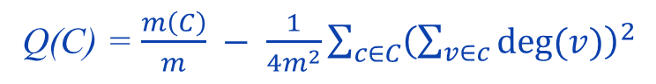
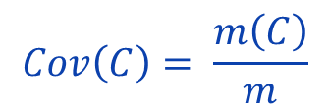
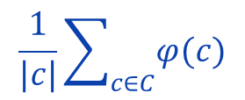
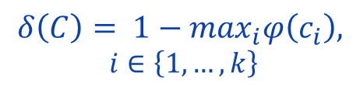
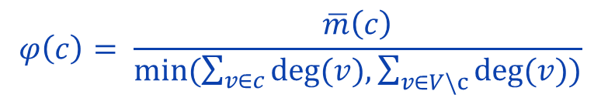
Structural Quality
$$Cov\left(C\right)= \frac{m\left(C\right)}{m}$$
Coverage
Modularity
Conductance
Inter-cluster conductance
Average conductance
Q(C) = $\frac{m\left(C\right)}{m} − \frac{1}{4m^{2}}\sum_{c∈C}{{\left(\sum_{v∈c}{deg⁡(v)}\right)}^{2}}$
$$φ\left(c\right)= \frac{\overline{m}\left(c\right)}{min⁡(\sum_{v∈c}{deg⁡(v),\sum_{v∈V\backslash c}{deg⁡(v))}}}$$
$$δ\left(C\right)= 1−\max_{i}φ\left(c_{i}\right),$$
$$i∈\left\{1,…,k\right\}$$
$$\frac{1}{|c|}\sum_{c∈C}{φ(c)}$$
Community coverage
Overlap coverage
Overlapping
Clusterings

Slide 12
Logical Quality
We define the logical quality based on the type of the edges inside the communities.
Homogeneous communities have perfect logical quality
The percentage of homogeneous communities in a network can be used to assess the logical quality of the network.

Slide 13

Experimental Evaluation
Email traffic was collected on a 10 Gbps backbone link during 14 days
Emails were classified as:
Legitimate (Ham)
Unsolicited (Spam)
Implicit social network were created:
Nodes: Email addresses
Edges: Transmitted Emails
Daily and weekly email networks were studied:
14 daily networks
2 weekly networks
1 complete network
1.6 million nodes and 2.8 million edges
OptoSUNET Core Network
SUNET Customers
Access Routers
2 Core Routers
40 Gb/s
10 Gb/s (x2)
NORDUnet
Main Internet

Slide 14
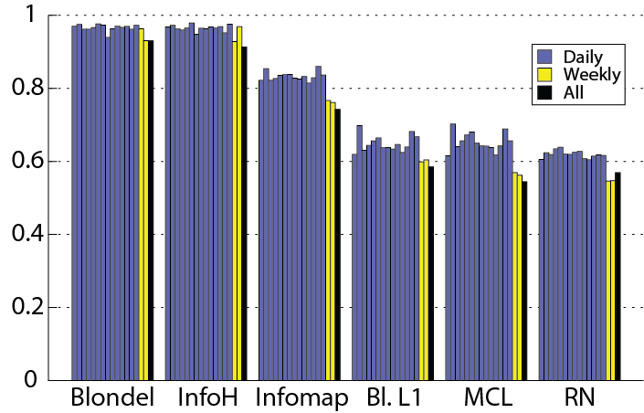
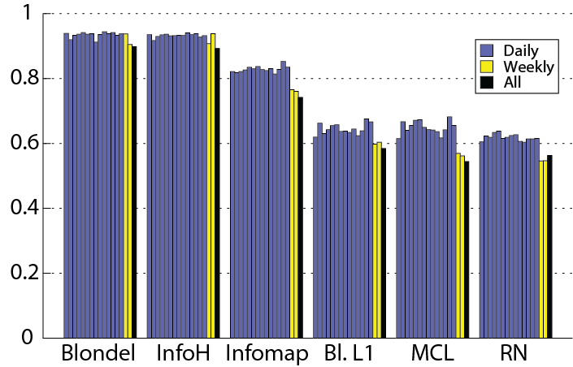
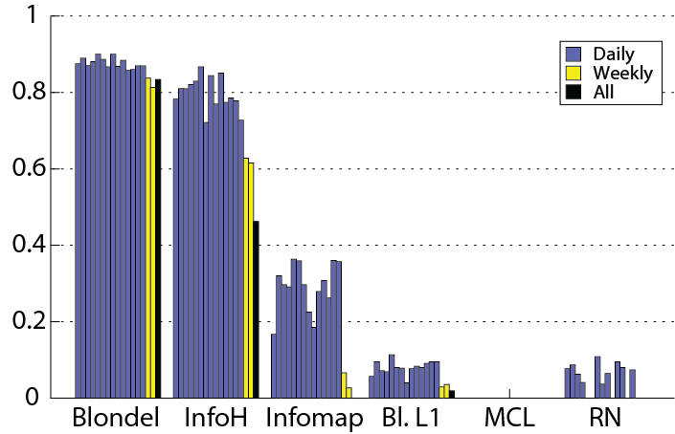
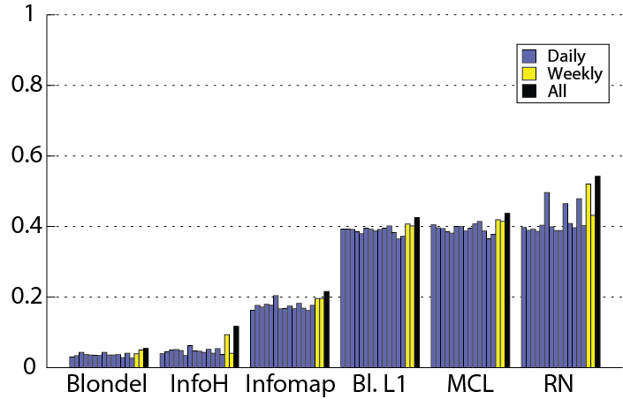
Experimental Results Structural Quality
Coverage
Modularity
Inter-cluster
conductance
Average
conductance
Community and overlap coverage are used for assessing quality of LC

Slide 15
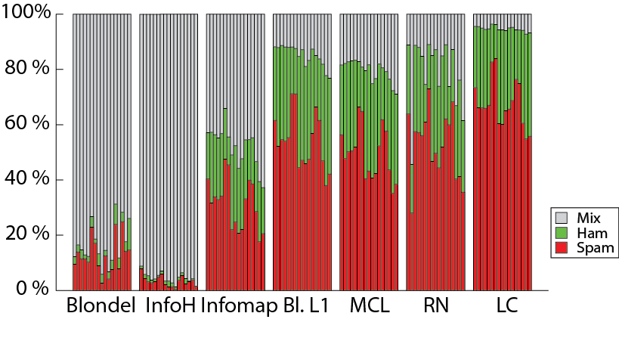
Experimental Results Logical Quality
Comparison of the percentage of spam, ham, and mix communities

Slide 16
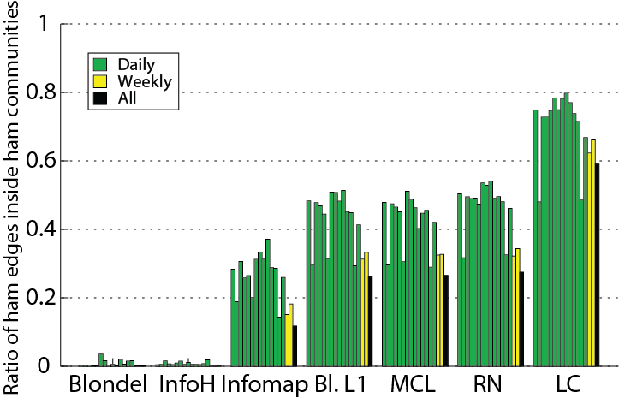
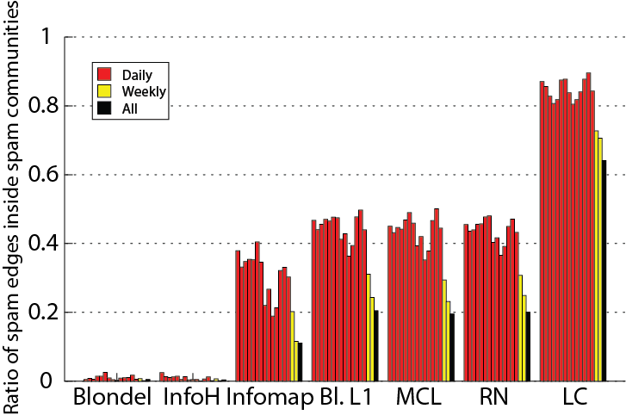
Experimental Results Logical Quality
The amount of spam and ham emails that have been separated by community detection algorithms

Slide 17
Summary
The algorithms that create coarse-grained communities achieve the best structural quality, but the worst logical quality.
Blondel and InfoH
The algorithms that create communities with similar granularity, achieve similar structural and logical quality.
Blondel L1, MCL, and RN
The algorithm that creates communities based on the edges of the network achieves the best logical quality.
LC

Slide 18
Conclusions
Yielding high structural quality by community detection algorithms is not enough to unfold the true logical communities of the email networks.
Link community detection is the most suitable approach for separating spam and ham emails into distinct communities.
It is necessary to deploy more realistic measures for clustering real-world networks.
Thank You!

